Slide 1
MATLAB for Engineering Applications Fifth Edition
William J. Palm III
© McGraw Hill LLC. All rights reserved. No reproduction or distribution without the prior written consent of McGraw Hill LLC.

Slide 2
Chapter 06
Model Building and Regression

Slide 3
Model building and regression
An important application of the plotting techniques is function discovery, the technique for using data plots to obtain a mathematical function or “mathematical model” that describes the process that generated the data.
Function Discovery: A systematic way of finding an equation that best fits the data is regression (also called the least-squares method).

Slide 4
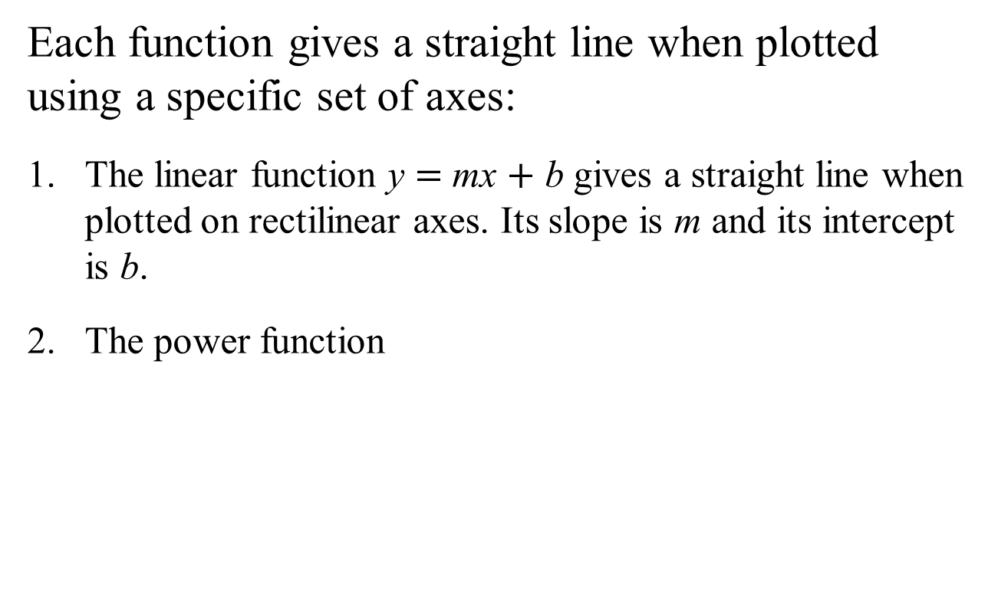
Using the Linear, Power, and Exponential Functions to Describe Data
Each function gives a straight line when plotted using a specific set of axes:
The linear function y $=$ mx $+$ b gives a straight line when plotted on rectilinear axes. Its slope is m and its intercept is b.
The power function
gives a straight line when
plotted on log-log axes.
The exponential function
and its equivalent
form
give a straight line when plotted on a
semilog plot whose y-axis is logarithmic.

Slide 5
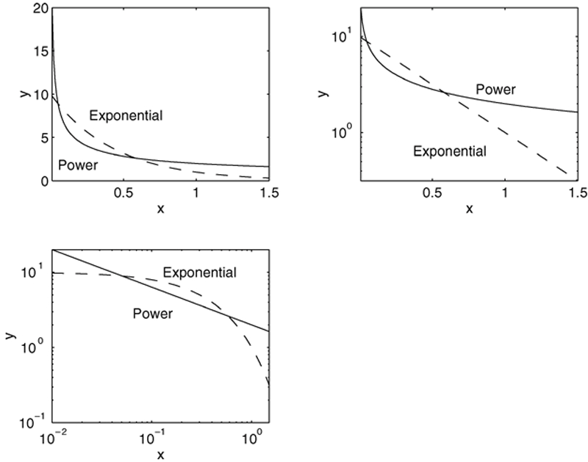
Function Discovery
The power function
and the exponential function
plotted on linear, semi-log, and log-log axes.
Access the text alternative for slide images.

Slide 6
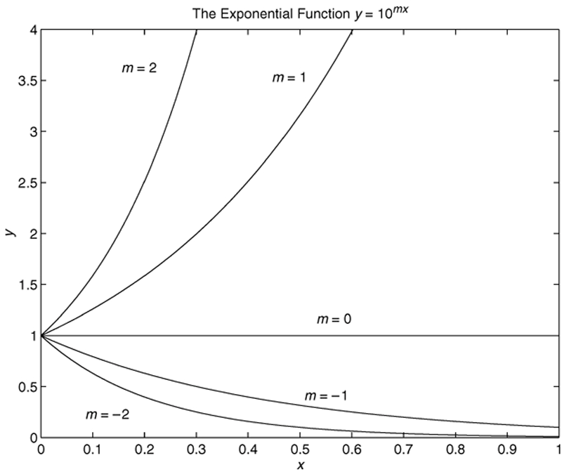
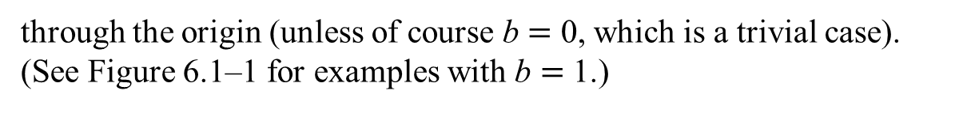
Steps for Function Discovery
Examine the data near the origin. The exponential function
or
can never pass
through the origin (unless of course b $=$ 0, which is a trivial case). (See Figure 6.1$\text{–}$1 for examples with b $=$ 1.)

Slide 7
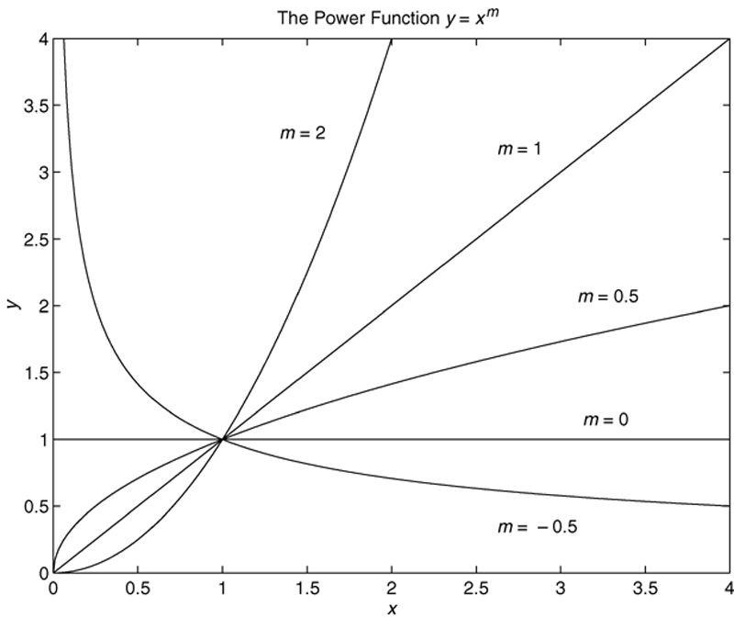
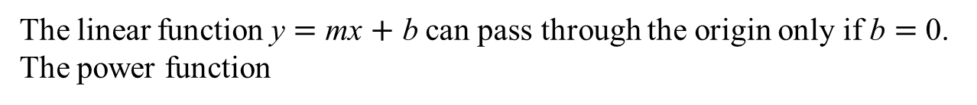
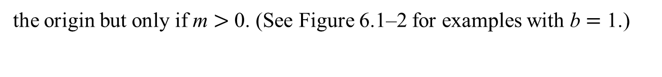
Example Plots of Exponential Functions
The linear function y $=$ mx $+$ b can pass through the origin only if b $=$ 0. The power function
can pass through
the origin but only if m $>$ 0. (See Figure 6.1$\text{–}$2 for examples with b $=$ 1.)

Slide 8

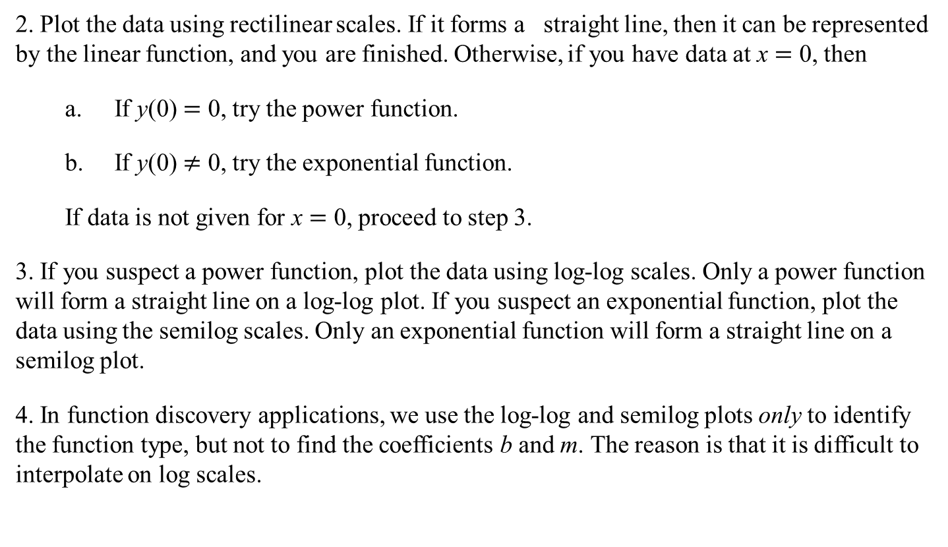
Steps for Function Discovery
2. Plot the data using rectilinear scales. If it forms a straight line, then it can be represented by the linear function, and you are finished. Otherwise, if you have data at x $=$ 0, then
a. If y(0) $=$ 0, try the power function.
b. If y(0) $≠$ 0, try the exponential function.
If data is not given for x $=$ 0, proceed to step 3.
3. If you suspect a power function, plot the data using log-log scales. Only a power function will form a straight line on a log-log plot. If you suspect an exponential function, plot the data using the semilog scales. Only an exponential function will form a straight line on a semilog plot.
4. In function discovery applications, we use the log-log and semilog plots only to identify the function type, but not to find the coefficients b and m. The reason is that it is difficult to interpolate on log scales.
Power function y $=$ bx^{m}
Exponential function y $=$ b(10)^{mx}

Slide 9
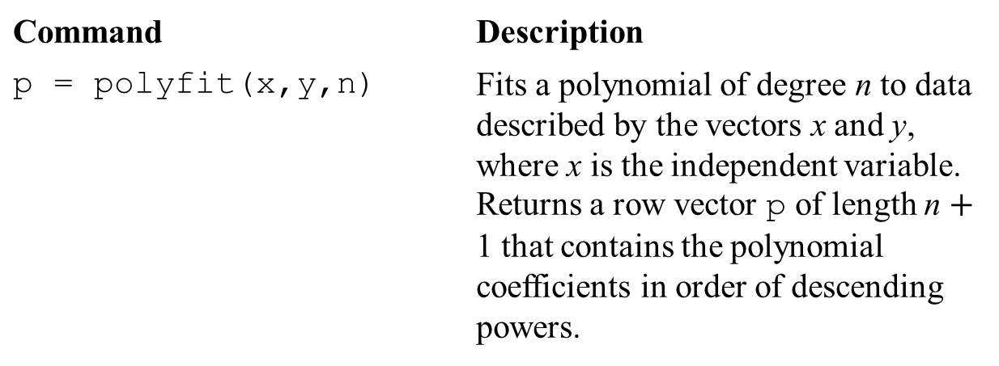
The polyfit Function
Command | Description
p = polyfit(x,y,n) | Fits a polynomial of degree n to data described by the vectors x and y, where x is the independent variable. Returns a row vector p of length n $+$ 1 that contains the polynomial coefficients in order of descending powers.
Syntax: p = polyfit(x,y,n)
where x and y contain the data, n is the order of the polynomial to be fitted, and p is the vector of polynomial coefficients.

Slide 10
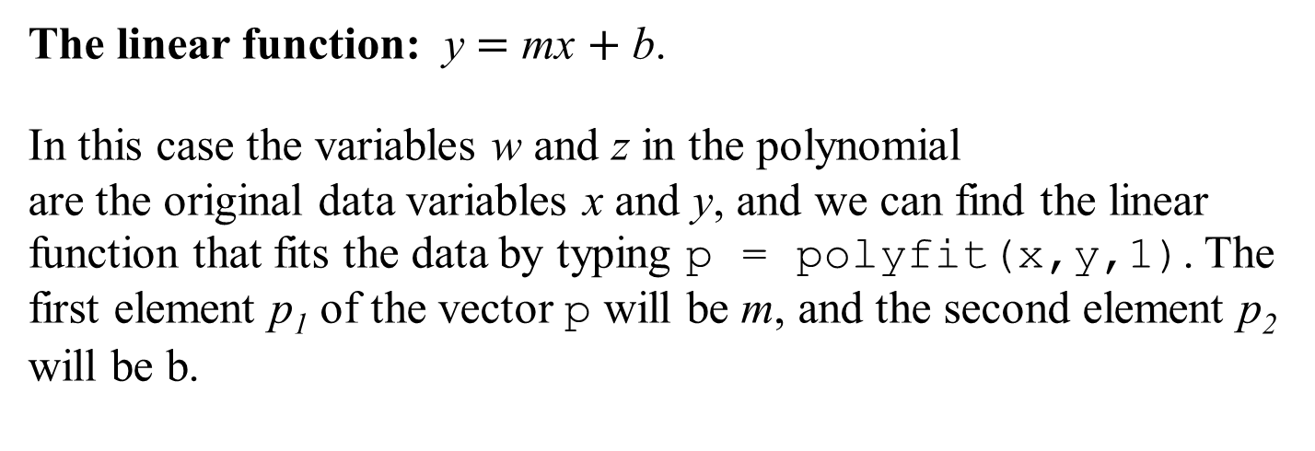
Using polyfit to Fit Equations to Data
The linear function: y $=$ mx $+$ b.
In this case the variables w and z in the polynomial are the original data variables x and y, and we can find the linear function that fits the data by typing p = polyfit(x,y,1). The first element p₁ of the vector p will be m, and the second element p₂ will be b.

Slide 11
The Power Function
The power function:
In this case
which has the form
where the polynomial variables w and z are related to the original data variables x and y by
and
Thus, we can
find the power function that fits the data by typing
p = polyfit(log10(x),log10(y),1)
The first element
of the vector p will be m, and the second
element
will be
We can find b from

Slide 12

The Exponential Function
The exponential function:
In this case
which has the form
where the polynomial variables w and z are related to the original data variables x and y by
and z $=$ x. We can find the
exponential function that fits the data by typing
p = polyfit(x, log10(y),1)
The first element
of the vector p will be m, and the second
element
will be
We can find b from

Slide 13
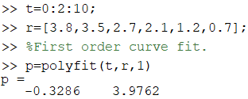
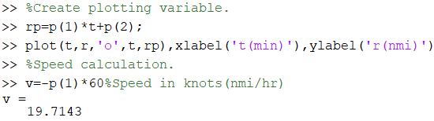
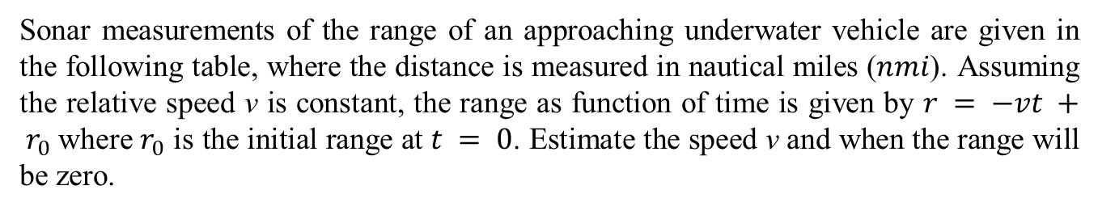
Fitting a Linear Function: Speed Estimation from Sonar Range Measurements: Example 6.1-1
Sonar measurements of the range of an approaching underwater vehicle are given in the following table, where the distance is measured in nautical miles ($nmi$). Assuming the relative speed v is constant, the range as function of time is given by $r = −vt + r_{0}$where $r_{0}$ is the initial range at $t = 0$. Estimate the speed v and when the range will be zero.
Time, t (min) | 0 | 2 | 4 | 6 | 8 | 10
Range, r (nmi) | 3.8 | 3.5 | 2.7 | 2.1 | 1.2 | 0.7
The speed v = the slope = 0.3286 nmi/min = 0.3286 nmi/min x 60min/hr = 19.7143 nmi/hr
From the regression model r = -0.3286 t + 3.9762 when r = 0 then t = 12.1 min

Slide 14
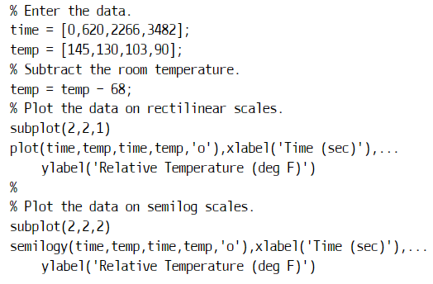


Example: Fitting an exponential function
The temperature of coffee cooling in a mug at room temperature (68°F) was measured at various times. The data follow.
Time t (sec) | Temperature T (°F)
0 | 145
620 | 130
2266 | 103
3482 | 90
Develop an exponential function model of the coffee’s temperature as a function of time, and use the model to estimate how long it took the temperature to reach 120°F.
The data can be described with the
Exponential function:

Slide 15

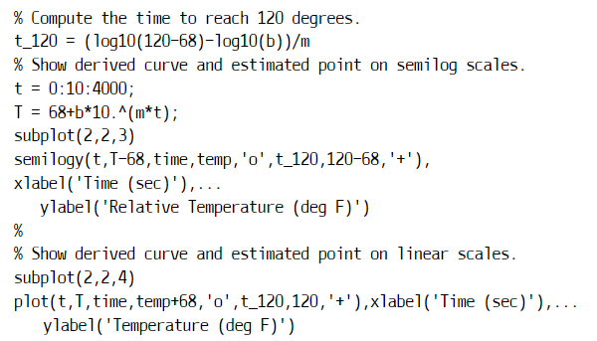
The computed values are m = -1.5557x10-4 and b = 77.4469.
Thus, the derived Model is
To estimate how long it will take for the coffee to cool to 120ºF. We must solve the equation: for t.
The solution is
The computed value of t_120 is 1113. Thus, the time to reach 120oG is 1112 sec.

Slide 16
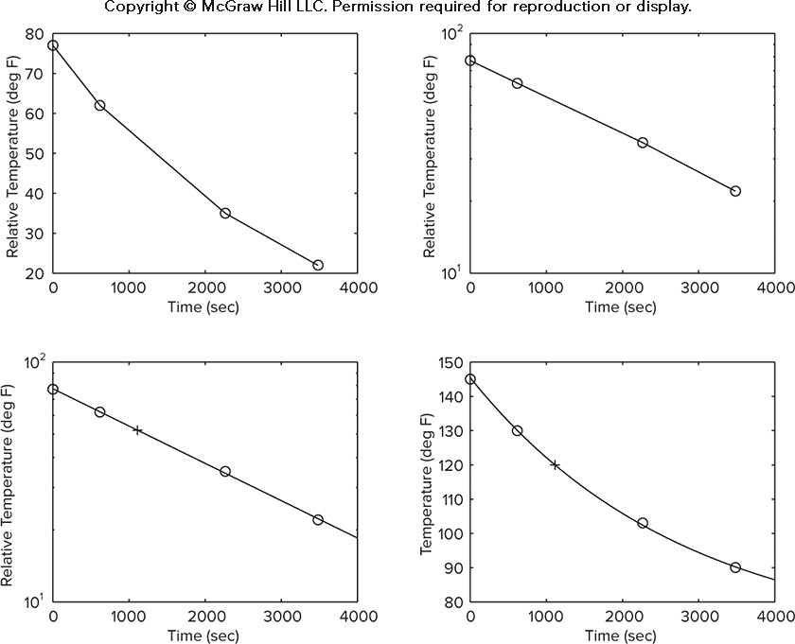
Fitting an Exponential Function: Temperature of a Cooling Cup of Coffee: Example 6.1-2
Access the text alternative for slide images.

Slide 17
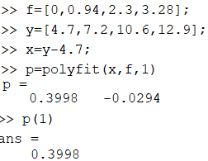
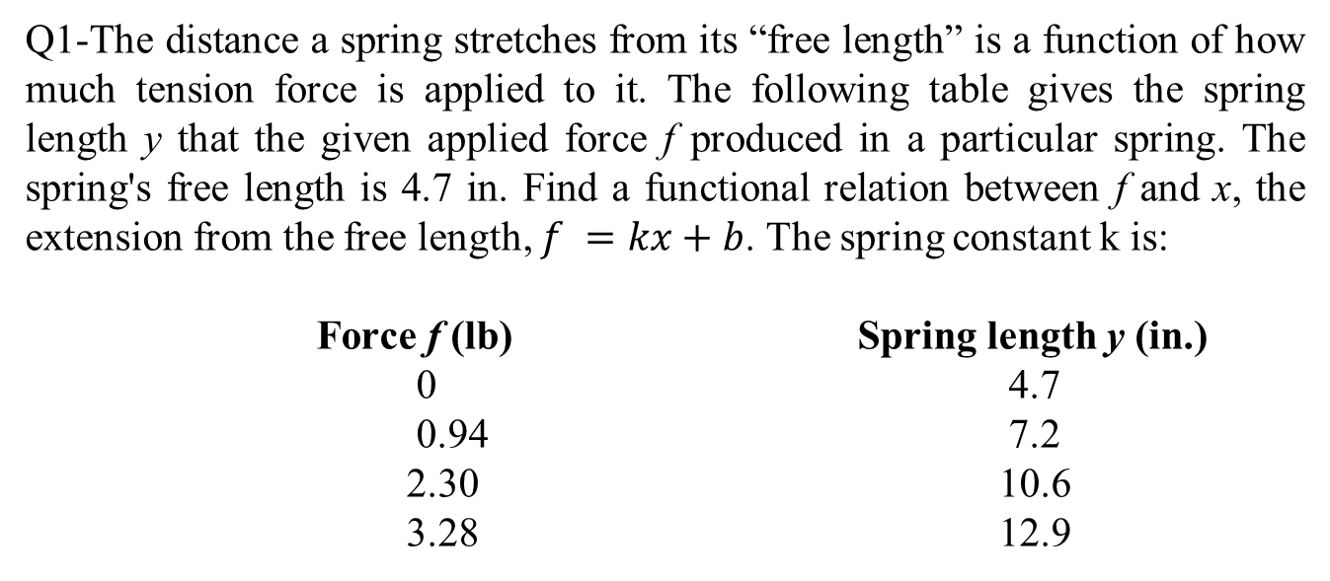
Question 1
Q1-The distance a spring stretches from its “free length” is a function of how much tension force is applied to it. The following table gives the spring length y that the given applied force f produced in a particular spring. The spring's free length is 4.7 in. Find a functional relation between f and x, the extension from the free length, $f =kx+b$. The spring constant k is:
Force f (lb) Spring length y (in.)
0 4.7
0.94 7.2
2.30 10.6
3.28 12.9
0.1
0.2
0.3
0.4 (correct)

Slide 18
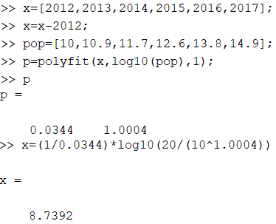
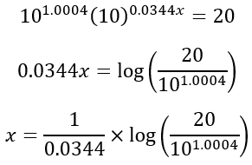
Question 2
Q2. The population data for a certain country are as follows:
Year 2012 2013 2014 2015 2016 2017
Population (millions) 10 10.9 11.7 12.6 13.8 14.9
Obtain an exponential function that describes these data. How many years after 2012 will the population be double its 2012 size (20 millions)?

Slide 19
The Least Squares Criterion
The Least Squares Criterion: used to fit a function f (x). It minimizes the sum of the squares of the residuals, J. J is defined as
We can use this criterion to compare the quality of the curve fit for two or more functions used to describe the same data. The function that gives the smallest J value gives the best fit.

Slide 20
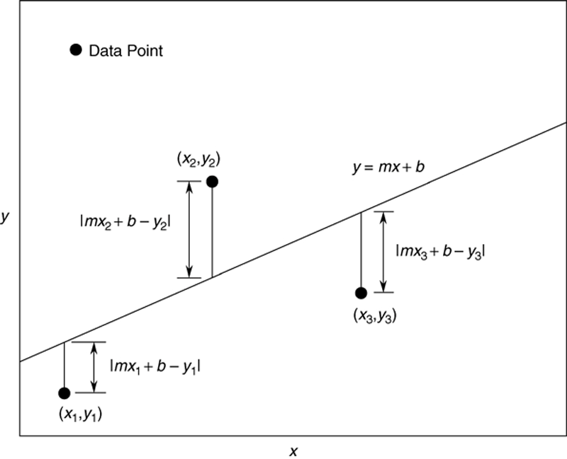
Illustration of the Least Squares Criterion
Access the text alternative for slide images.

Slide 21
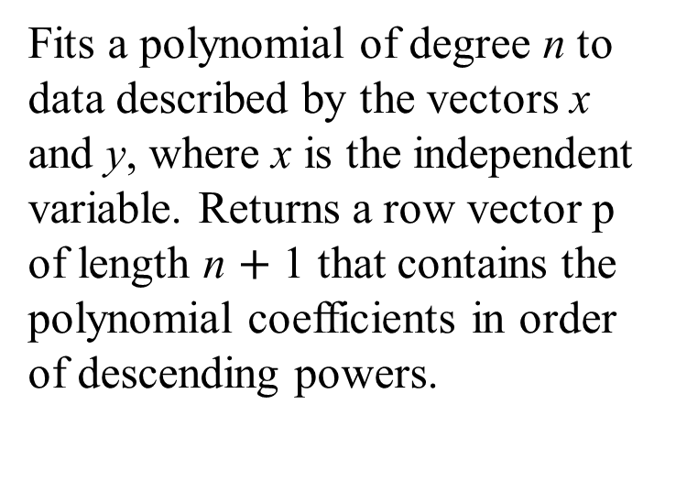
The polyfit Function Is Based on the Least Squares Method
Its syntax is
p = polyfit(x,y,n)
Fits a polynomial of degree n to data described by the vectors x and y, where x is the independent variable. Returns a row vector p of length n $+$ 1 that contains the polynomial coefficients in order of descending powers.

Slide 22
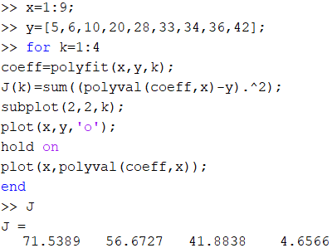
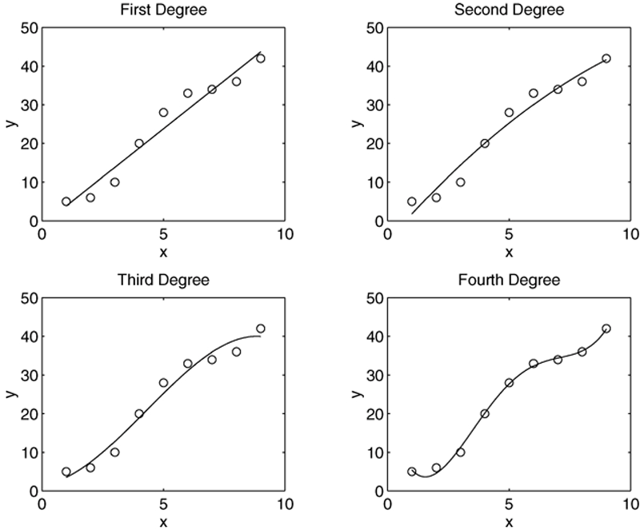
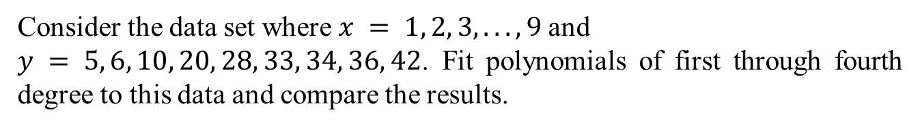
Regression Using Polynomials of First through Fourth Degree
Consider the data set where $x = 1, 2, 3, . . . , 9$and
$y = 5, 6, 10, 20, 28, 33, 34, 36, 42$. Fit polynomials of first through fourth degree to this data and compare the results.
Fourth order is the best option with a minimized error!

Slide 23
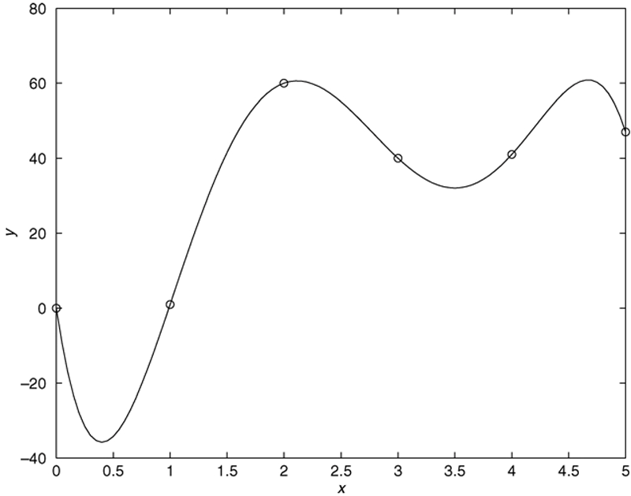
Beware of Using Polynomials of High Degree
This fifth-degree polynomial passes through all six data points but exhibits large excursions between points.
Access the text alternative for slide images.

Slide 24
Assessing the Quality of a Curve Fit 1
Denote the sum of the squares of the deviation of the y values from their mean y by S, which can be computed from
This formula can be used to compute another measure of the quality of the curve fit, the coefficient of determination, also known as the r-squared value. It is defined as
The value of S indicates how much the data is spread around the mean, and the value of J indicates how much of the data spread is unaccounted for by the model.
Thus, the ratio J/S indicates the fractional variation unaccounted for by the model.

Slide 25

Assessing the Quality of a Curve Fit 2
For a perfect fit, J $=$ 0 and thus
Thus, the closer
is
to 1, the better the fit. The largest
can be is 1.
It is possible for J to be larger than S, and thus it is possible for
to be negative. Such cases, however, are indicative of
a very poor model that should not be used.
As a rule of thumb, a good fit accounts for at least 99 percent of the data variation. This value corresponds to

Slide 26
Scaling the Data
The effect of computational errors in computing the coefficients can be lessened by properly scaling the x values. You can scale the data yourself before using polyfit. Some common scaling methods are
Subtract the minimum x value or the mean x value from the x data, if the range of x is small, or
Divide the x values by the maximum value or the mean value, if the range is large.

Slide 27
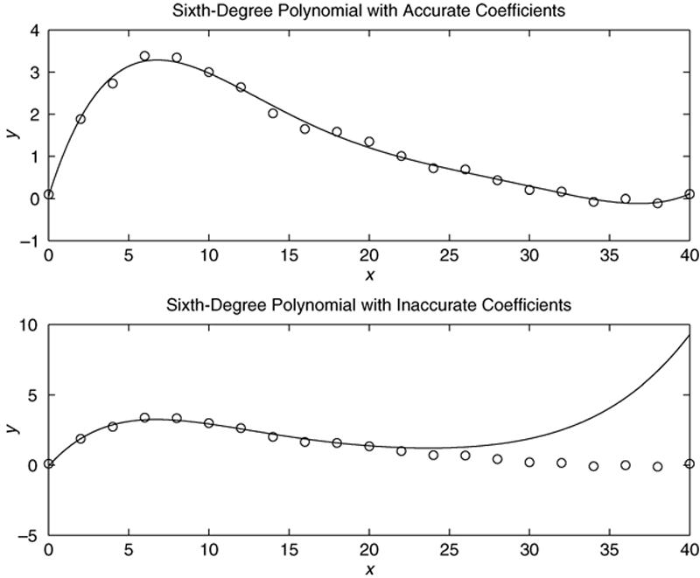
Effect of Coefficient Accuracy on a Sixth-Degree Polynomial
Top graph: 14 decimal-place accuracy
Bottom graph: 8 decimal-place accuracy
High-degree polynomials can produce large errors if their coefficients are not represented with a large number of significant figures.

Slide 28
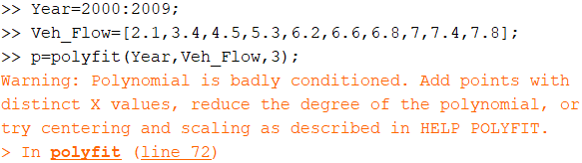
Example: Scaling the data
The following data give the number of vehicles (in millions) crossing a bridge each year for 10 years. Fit a cubic polynomial to the data and use the fit to estimate the flow in the year 2010.
Year | 2000 | 2001 | 2002 | 2003 | 2004 | 2005 | 2006 | 2007 | 2008 | 2009
Vehicle flow(millions) | 2.1 | 3.4 | 4.5 | 5.3 | 6.2 | 6.6 | 6.8 | 7 | 7.4 | 7.8
No meaningful solution/formulation, so it may need scaling!

Slide 29
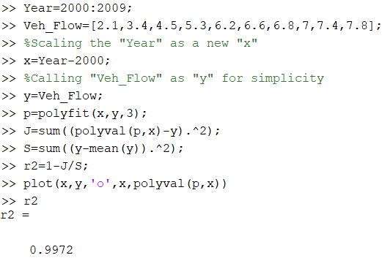

Example: Scaling the data
Correct solution using scaling!
Acceptable r²
$$f(t)={0.0087(t−2000)}^{3}−{0.1851(t−2000)}^{2}+1.5991(t−2000)+2.0362$$
f (2010)=8.21

Slide 30
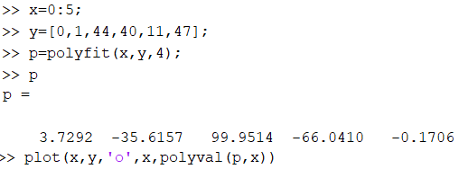
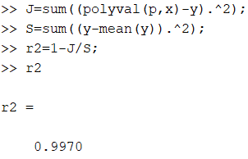
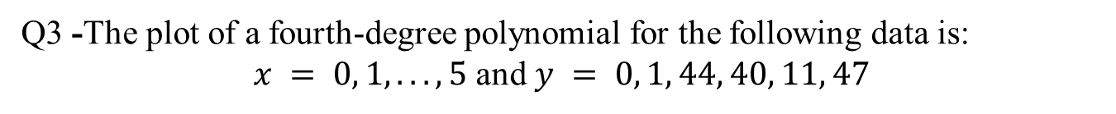
Question 3
Q3 -The plot of a fourth-degree polynomial for the following data is:
$x = 0, 1, . . . , 5$ and $y = 0, 1, 44, 40, 11, 47$
Acceptable r²

Slide 31
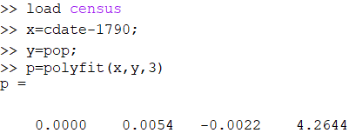
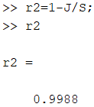
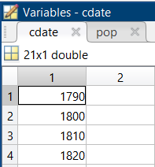
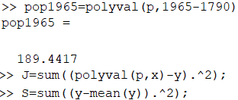
Question 4
Q4- The U.S. census data from 1790 to 1990 is stored in the file census. dat, which is supplied with MATLAB. Type load census to load this file. The first column, cdate, contains the years, and the second column, pop, contains the population in millions. First try to fit a cubic polynomial to the data. If you get a warning message, scale the data by subtracting 1790 from the years, and fit a cubic. The coefficient of determination (r-squared value) is:
Acceptable r²
Example pop in 1965

Slide 32
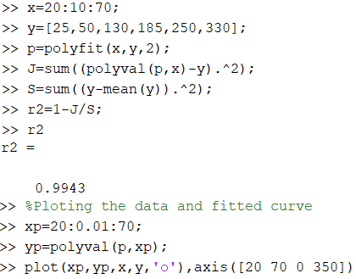
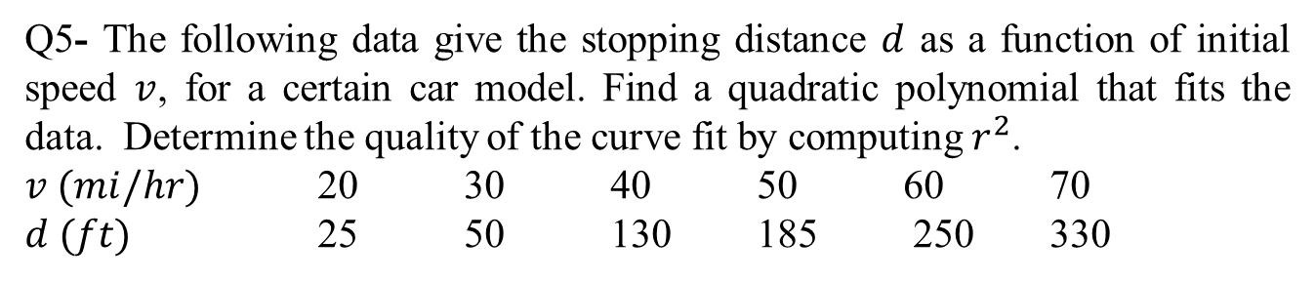
Question 5
Q5- The following data give the stopping distance $d$ as a function of initial speed $v$, for a certain car model. Find a quadratic polynomial that fits the data. Determine the quality of the curve fit by computing $r^{2}$.
$v (mi/hr)$ 20 30 40 50 60 70
$d (ft)$ 25 50 130 185 250 330
0.9921
0.9943 (correct)
0.9962
0.9998

Slide 33
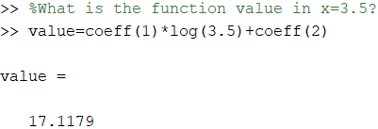
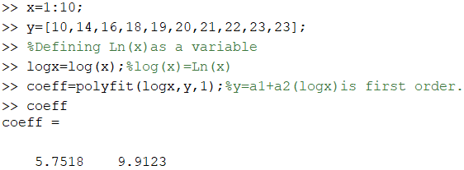
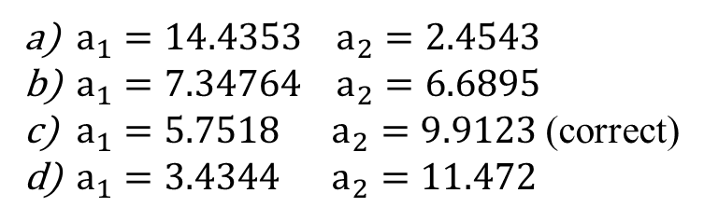
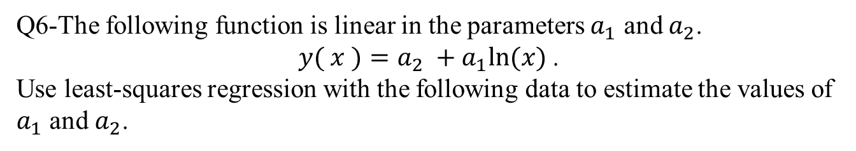
Question 6
Q6-The following function is linear in the parameters $a_{1}$ and $a_{2}$.
$y( x )=a_{2} +a_{1}ln⁡(x)$.
Use least-squares regression with the following data to estimate the values of $a_{1}$ and $a_{2}$.
x | 1 | 2 | 3 | 4 | 5 | 6 | 7 | 8 | 9 | 10
y | 10 | 14 | 16 | 18 | 19 | 20 | 21 | 22 | 23 | 23
$a_{1}=14.4353 { a}_{2}=2.4543$
$a_{1}=7.34764 { a}_{2}=6.6895$
$a_{1}=5.7518 { a}_{2}=9.9123$(correct)
$a_{1}=3.4344 a_{2}=11.472$

Slide 34
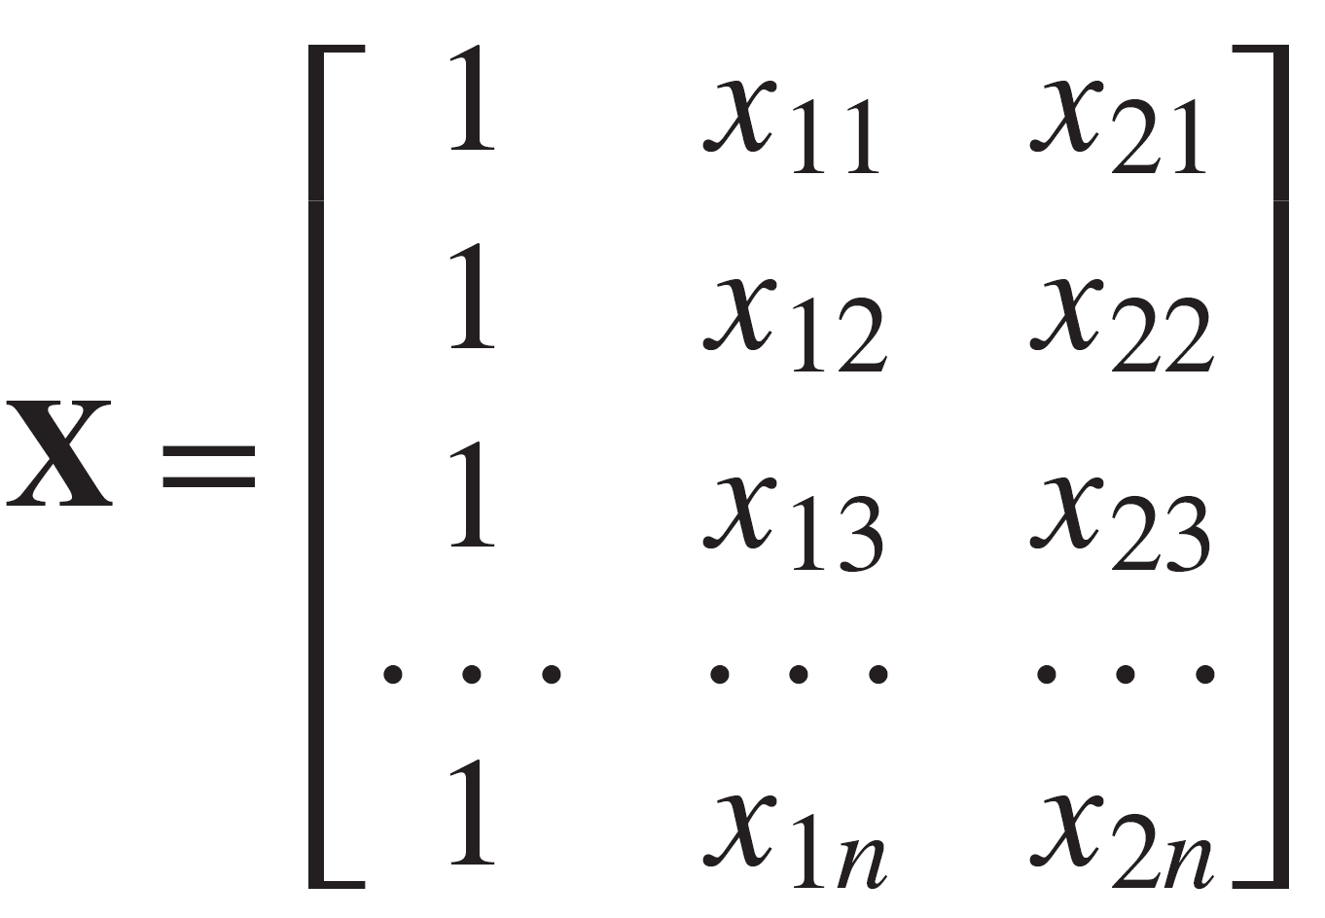
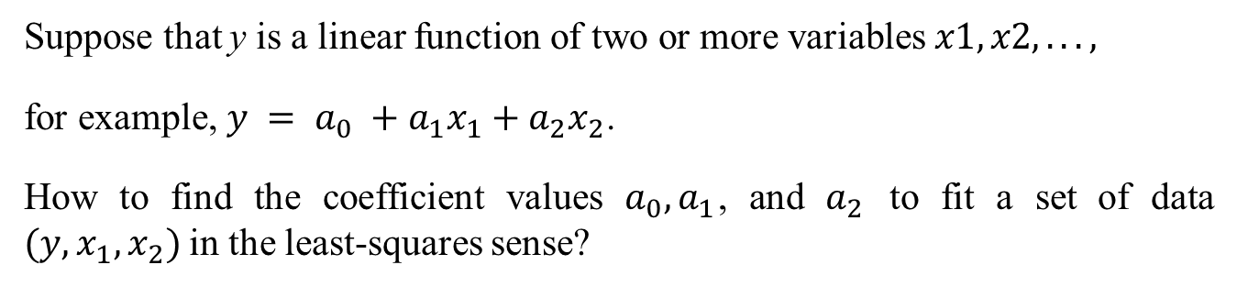
Multiple linear regression
Suppose that y is a linear function of two or more variables $x1, x2, . . . ,$
for example, $y = a_{0} +a_{1}x_{1}+a_{2}x_{2}$.
How to find the coefficient values $a_{0}, a_{1}$, and $a_{2}$ to fit a set of data $(y,x_{1},x_{2})$in the least-squares sense?
The solution for the coefficients is given by a = X\y.

Slide 35
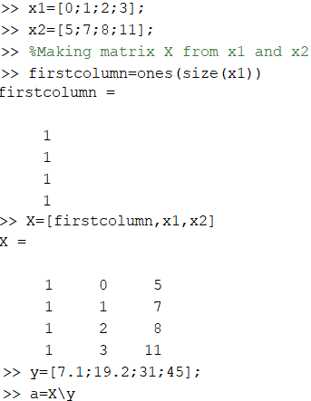
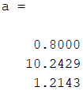
Example: Multiple linear regression
Obtain a linear model $y = a_{0} +a_{1}x_{1}+a_{2}x_{2}$ to describe the relationship.
Breaking strength (kN) | % of element 1 | % of element 2
y | x₁ | x₂
7.1 | 0 | 5
19.2 | 1 | 7
31 | 2 | 8
45 | 3 | 11

Slide 36
Linear-in-parameters regression
Sometimes we want to fit an expression that is neither a polynomial nor a function that can be converted to linear form by a logarithmic or other transformation.
In some cases, we can still do a least-squares fit if the function is a linear expression in terms of its parameters.
Example: The following data gives the output voltage of a certain device as a function of time. Obtain a function that describes this data.
$v(t) = a_{1}+a_{2}e^{−t/T}$(first-order model)
The first-order model written for each of the n data points results in n equations, which can be expressed as follows:
Xa = y′

Slide 37
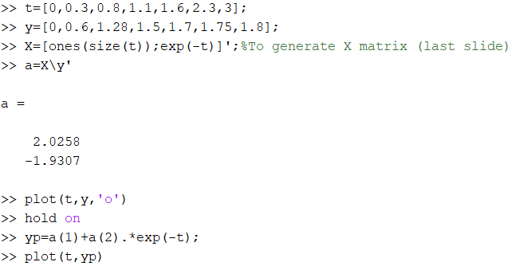
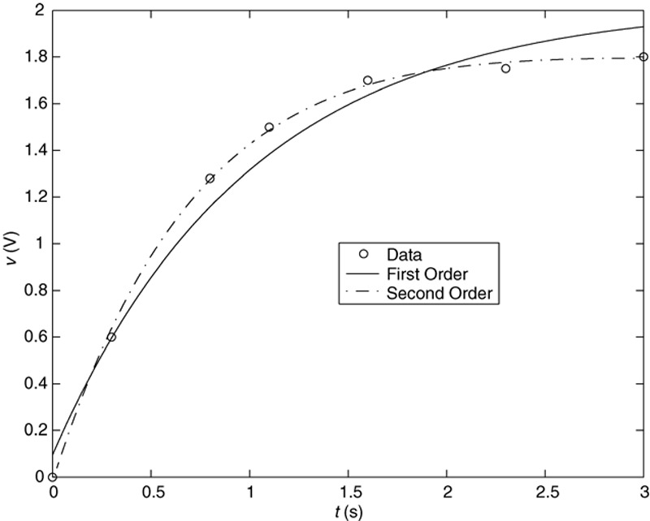
Example: Linear-in-parameters regression
$y(t) = a_{1}+a_{2}e^{−t}$(first-order model)
Data for t and y

Slide 38

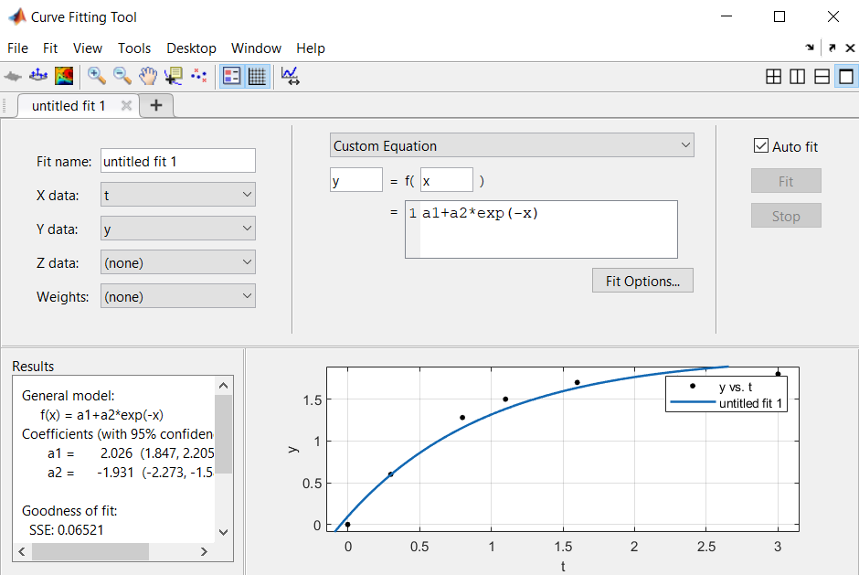

Cftool
$y(t) = a_{1}+a_{2}e^{−t}$(first-order model)

Slide 39


Question 7
Q7- Obtain a linear model $y=a_{0}+a_{1}x_{1}+a_{2}x_{2}$for the following data to describe the relationship. The maximum error is
y x1 x2
3.8 7.5 6
5.6 6 9
6 13.5 10.5
5 16.5 18
5.8 19.5 21
5.6 21 25.5
$\text{Max}\text{_}\text{error}\text{ = 1.0847 (}\text{correct}\text{)}$
$\text{Max}\text{_}\text{error}\text{ = 2.1249}$
$\text{Max}\text{_}\text{error}\text{ = 3.8926}$
$\text{Max}\text{_}\text{error}\text{ = 4.3285}$

Slide 40

Question

Slide 41


Question 8
Q8- Using cftool toolbox, find a polynomial function that fits following t and y data.

Slide 42


Using Residuals
The following table gives data on the growth of a certain bacteria population with
time. Fit an equation to these data.

Slide 43

Using Residuals
Residual plots of four models
The cubic is the best fit of the four models considered. Its coefficient of determination
is r² = 0.9999. The model is

Slide 44
Basic Fitting Interface
MATLAB supports curve fitting through the Basic Fitting interface. Using this interface, you can quickly perform basic curve fitting tasks within the same easy-to-use environment. The interface is designed so that you can:
Fit data using a cubic spline or a polynomial up to degree 10.
Plot multiple fits simultaneously for a given data set.
Plot the residuals.
Examine the numerical results of a fit.
Interpolate or extrapolate a fit.
Annotate the plot with the numerical fit results and the norm of residuals.
Save the fit and evaluated results to the MATLAB workspace.

Slide 45

A Figure Produced by the Basic Fitting Interface: Figure 6.3-2
Access the text alternative for slide images.
Source: MATLAB

Slide 46
End of Main Content
© McGraw Hill LLC. All rights reserved. No reproduction or distribution without the prior written consent of McGraw Hill LLC.

